Slide 1

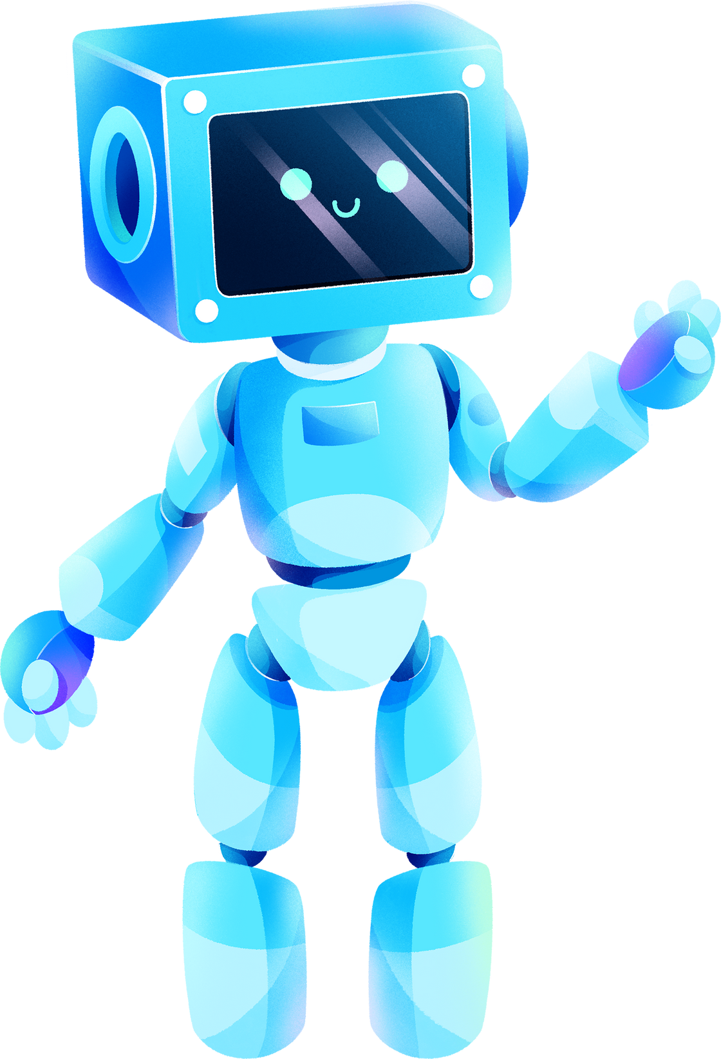

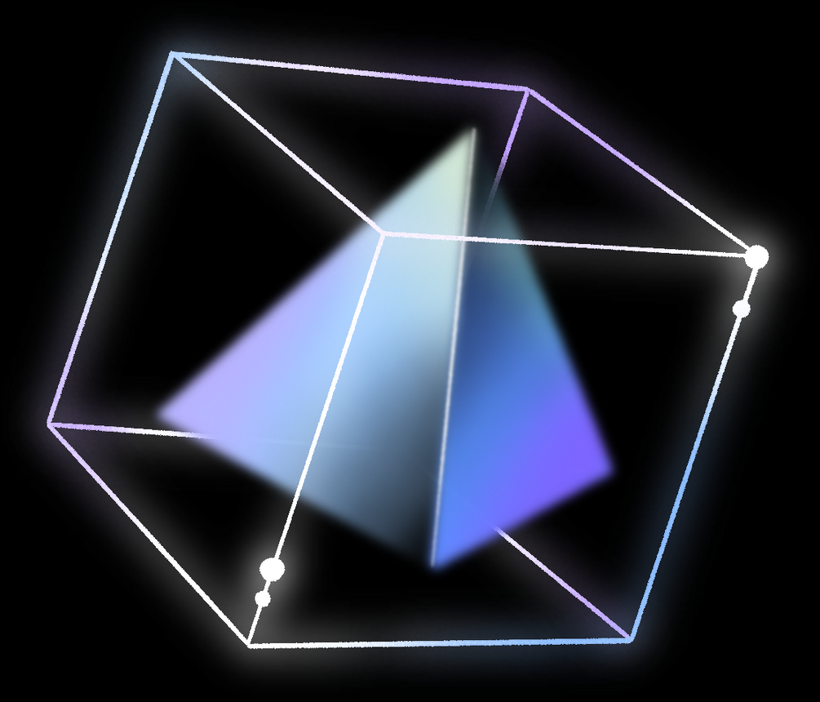
ChatGPT
By:
K.Lakshmi
K.Parash Kumari
A.Manasa

Slide 2

TABLE OF CONTENTS:
Introduction
Understanding ChatGPT&How it Works
Language Understanding& Language Generation
Applications of ChatGPT
Benefits of using ChatGPT
Challenges & Limitations
Conclusion
01
02
03
04
05
06
07

Slide 3

Introduction:
An AI-powered conversational agent developed by OpenAI.
Utilizes state-of-the-art deep learning models.
Designed to understand and generate human-like text .
Has various applications.

Slide 4
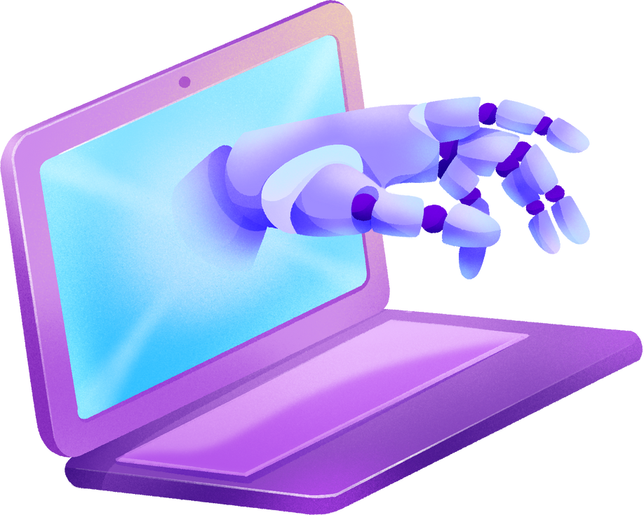
Understanding ChatGPT&How it Works:
Operates by processing input text through layers of neural networks .
GPT-3.5, is capable of NLU and NLG.
Learns from vast amounts of text data .

Slide 5

Language Understanding& Language Generation:
Demonstrates a high level of language understanding.
Discern the meaning behind user queries.
Can handle various languages and dialects.
Versatile for global applications.
Express ideas creatively and mimics human conversation.
Produces diverse range of content .

Slide 6

Applications
1
2
3
4
Customer support,
Personal Assistance
Content creation
Education and tutoring
Language translation

Slide 7





BENEFITS OF USING CHATGPT:
Utilizing ChatGPT offers several advantages:
Time-saving
Scalability
Consistency
24/7 availability
Language versatility

Slide 8
Challenges & Limitations
1
2
3
4
Ethical concerns
Bias and fairness issues
Context understanding limitations
Handling sensitive information security and maintaining user privacy.

Slide 9



Conclusion:
Conversational AI at its finest.
Offers a wide range of applications and benefits.
Bridges the gap between humans and machines.
Revolutionizes how we interact with technology and each other.

Slide 10
ANY QUERIES?

Slide 11
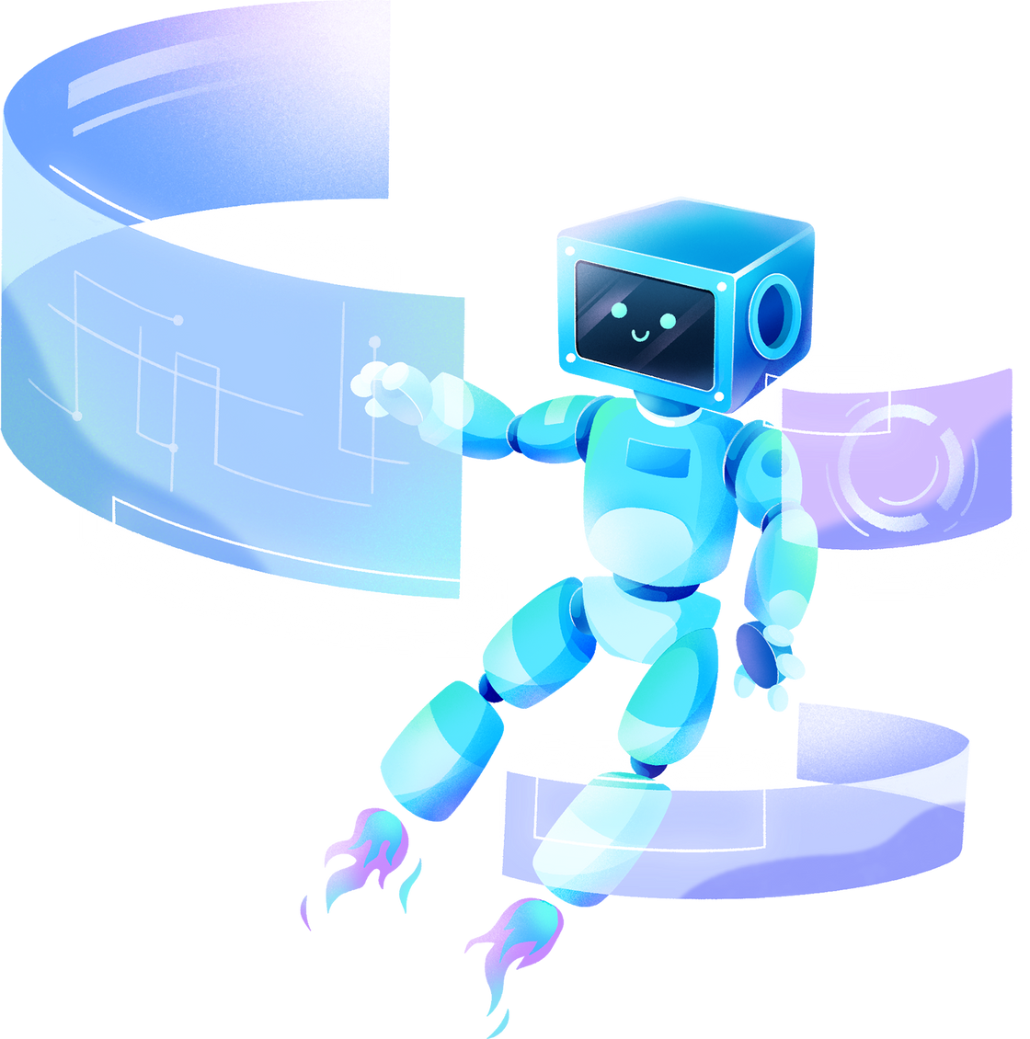
THANK YOU

